Slide 1
Checking and securing understanding of fractions
Comparing and ordering fractions and decimals (positive and negative)

Slide 2
how to use Oak lessons

Slide 3
I can represent fractions as numbers.

Slide 4

A numerator is the expression in a fraction that is written above the fraction line. It is the dividend.
A denominator is the expression in a fraction that is written below the fraction line. It is the divisor.
numerator
Example
denominator

Slide 5

Checking and securing understanding of fractions
Using fractions to describe diagrams
Fractions as numbers on the number line

Slide 6

Using fractions to describe diagrams
One whole
 | ?
The whole can be split into equal parts.
The denominator represents the number of equal parts the whole has been divided into.
The numerator counts the number of equal parts that the fraction represents.

Slide 7
Using fractions to describe diagrams
What fraction of the whole rectangle is shaded?
This is

Slide 8
Using fractions to describe diagrams
What fraction of the whole rectangle is shaded?
Is
this
also
?
Yes, the 10 parts all have equal area.
So we can say that is shaded.

Slide 9
Using fractions to describe diagrams
What fraction of the whole rectangle is shaded?
Is
this
also
?
It is difficult to tell, there are 10 parts in the rectangle but they do not have equal area, so we cannot say this is shaded.

Slide 10
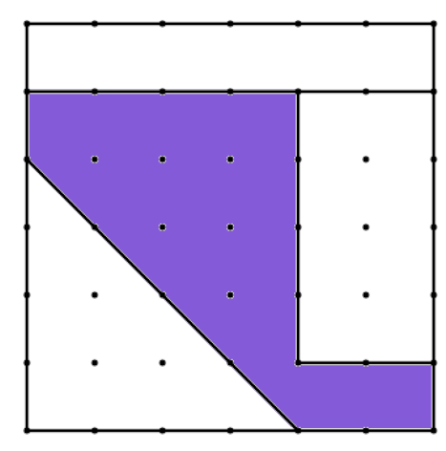
Using fractions to describe diagrams
This square has been drawn on a dotty grid. The dots are equally spaced.
Can we say what fraction of the square is shaded?

Slide 11
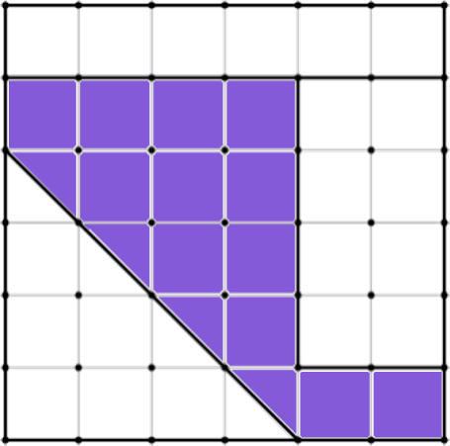
Using fractions to describe diagrams
This square has been drawn on a dotty grid. The dots are equally spaced.
Can we say what fraction of the square is shaded?
We could count the area shaded by imagining the grid made by the dots.
We can see that 12 whole squares and 4 half squares are shaded. So 14 small squares in total.

Slide 12


Using fractions to describe diagrams
This square has been drawn on a dotty grid. The dots are equally spaced.
Can we say what fraction of the square is shaded?
There are 36 small
This is equivalent to
squares in the larger
square,
meaning
is shaded.

Slide 13
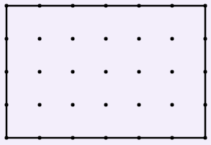
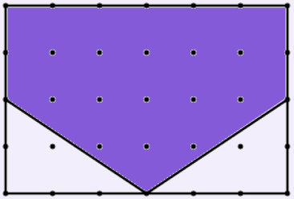
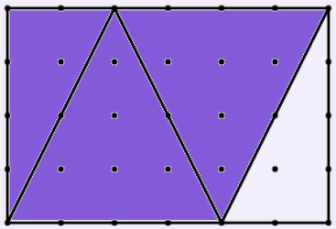
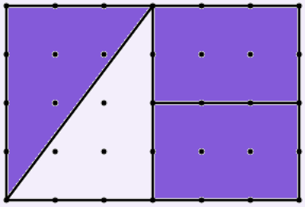
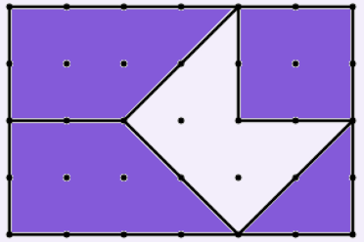


Using fractions to describe diagrams
Which of these correctly represent
of this rectangle being shaded?
a
b
c
d

Slide 14




Using fractions to describe diagrams
Which
is
larger
or
?
Paying attention to what is defined as the whole is important when using fractions to describe diagrams.

Slide 15

Using fractions to describe diagrams
We can use cuisenaire rods to represent fractions.
w
The pink (p) rod is half of the tan (t) rod.
r
t
g
p
p
The yellow (y) rod is half of the orange (O) rod.
y
d
O
b
y
t
The pink and yellow rods both represent
B
but in relation to different wholes.
O

Slide 16
Using fractions to describe diagrams
We can use cuisenaire rods to represent fractions.
w
If the dark green rod (d) represents 1,
r
1
g
d
p
what fraction does the light green rod (g) represent?
y
d
g
b
t
Light green (g) fits twice along
B
dark green (d) so the light
O
represents

Slide 17



Using fractions to describe diagrams
We can use cuisenaire rods to represent fractions.
w
What other fractions can you represent using these cuisenaire rods?
r
g
Some examples:
p
y
If y is 1, w is
and r is
y
w
w
w
w
w
d
r
b
If B is 1, g is
and d is
t
g
B
d
O
B

Slide 18

Using fractions to describe diagrams
Work out the missing lengths given that:
d
w
1
r
a)
g
g
?
p
y
b)
r
d
?
b
t
c)
y
B
?
O

Slide 19
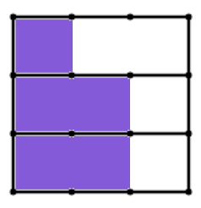
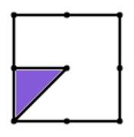
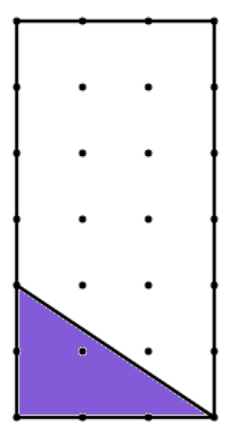
Using fractions to describe diagrams
1) What fraction of each diagram is shaded?
a)
b)
c)

Slide 20
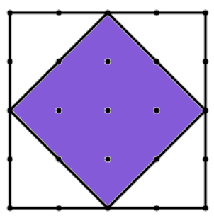
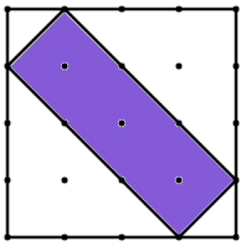
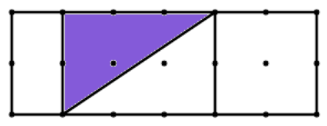
Using fractions to describe diagrams
1) What fraction of each diagram is shaded?
d)
e)
f)

Slide 21
Using fractions to describe diagrams
2) Work out the missing lengths given that:
t
w
1
r
a)
r
g
?
p
y
b)
p
d
?
b
t
c)
y
B
?
O

Slide 22
Using fractions to describe diagrams
3) Work out the missing lengths given that:
w
O
r
r
1
g
a)
d
p
y
?
d
b)
p
b
?
t
c)
B
B
O
?

Slide 23
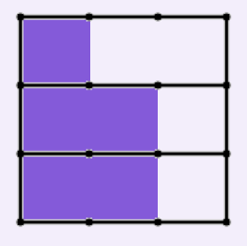
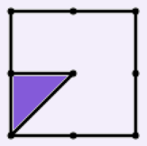
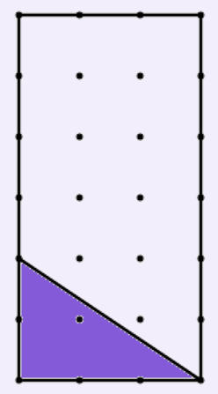




Using fractions to describe diagrams
1) What fraction of each diagram is shaded?
a)
b)
c)
or

Slide 24
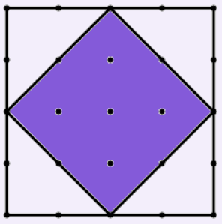
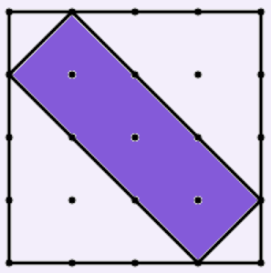
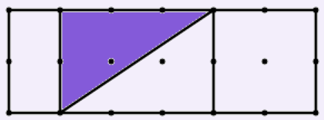
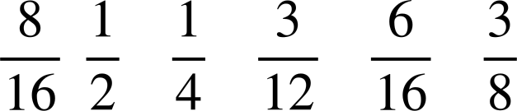
Using fractions to describe diagrams
1) What fraction of each diagram is shaded?
d)
e)
f)
or
or
or

Slide 25


Using fractions to describe diagrams
2) Work out the missing lengths given that:
t
w
1
r
a)
r
g
?
p
y
b)
p
d
?
b
t
c)
y
B
?
O

Slide 26
Using fractions to describe diagrams
3) Work out the missing lengths given that:
w
O
r
r
1
g
a)
d
p
y
?
d
b)
p
b
?
t
c)
B
B
O
?

Slide 27
Checking and securing understanding of fractions
Using fractions to describe diagrams
Fractions as numbers on the number line

Slide 28
Fractions as numbers on the number line
Mark the position of the number 3 on this number line.
Now mark the position of the number 1.
e.g.
1
3
Where is the position of the number 2 on your number line?
The 3 and 1 could have gone anywhere, as long as 1 was to the left of 3, but 2 must go half way between the 1 and 3

Slide 29
Fractions as numbers on the number line
Once you have two numbers on a number line, any other numbers should be positioned correctly relative to these.
0
7
Where would the number 5 be on this number line?

Slide 30
Fractions as numbers on the number line
Once you have two numbers on a number line, any other numbers should be positioned correctly relative to these.
0
7
5
Divide the line equally into 7 parts between 0 and 7
This means each section will be worth 1
Then you can place 5 correctly

Slide 31
Fractions as numbers on the number line
Which arrow shows the position of the number 3 on this number line?
0
5
a
b
c

Slide 32

Fractions as numbers on the number line
0
1
0
10
0

Slide 33
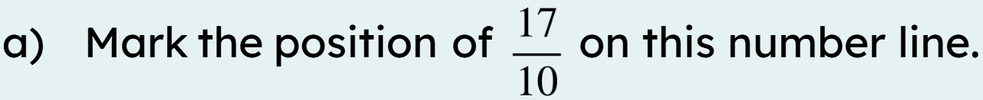

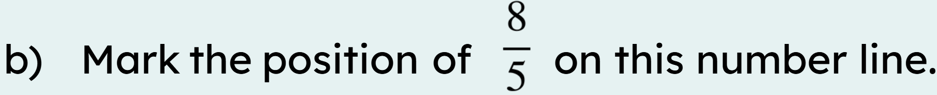

Fractions as numbers on the number line
Here is a number line.
0
1
2
0
1
2

Slide 34
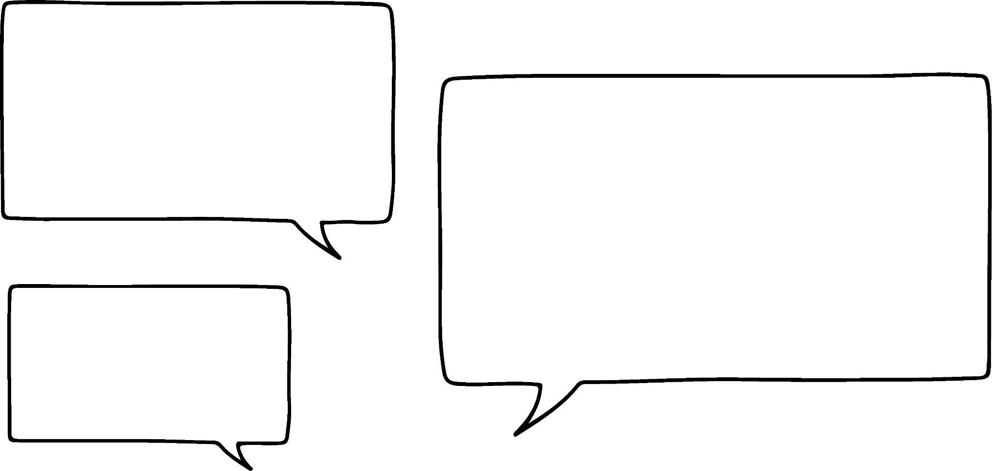



Fractions as numbers on the number line
Jacob has marked a fraction on this number line.
I counted 11 lines so it must be in 11ths. This is the 8th line along so it’s
0
1
Do you agree with Jacob?
No, the lines divide the number line into 10 equal parts, the arrow is pointing to

Slide 35
Fractions as numbers on the number line
1) Label the fraction the arrow is pointing to on each number line.
a)
0
1
b)
0
1

Slide 36
Fractions as numbers on the number line
1) Label the fraction the arrow is pointing to on each number line.
c)
0
1
2
d)
0
1
2

Slide 37

Fractions as numbers on the number line
2) Fill in the missing numbers on these number lines
0
0
0

Slide 38


Fractions as numbers on the number line
1) Label the fraction the arrow is pointing to on each number line.
a)
0
1
b)
or
0
1

Slide 39



Fractions as numbers on the number line
1) Label the fraction the arrow is pointing to on each number line.
c)
0
1
2
d)
or
0
1
2
or

Slide 40
Fractions as numbers on the number line
2) Fill in the missing numbers on these number lines
0
0
0

Slide 41
Checking and securing understanding of fractions
A numerator is the expression in a fraction that is written above the fraction line. It is the dividend.
A denominator is the expression in a fraction that is written below the fraction line. It is the divisor.
Fractions can be used to describe diagrams when we define what the part of the diagram represents the whole. The denominator must represent the number of equal parts the whole is divided into.
Fractions are numbers that can be placed on a number line by dividing the line equally.

Slide 42

© Oak National Academy 2023.
Produced in partnership with Mathematics in Education and Industry.
Licensed on the Open Government Licence v3.0, except where otherwise stated. See Oak terms and conditions.

